Slide 1
Electrical Heating
(Industrial Electronics)
Engr. M. Laiq Ur Rahman

Slide 2
Books
Following books have been used for preparing these slides:
Industrial Electronics and Control, 2nd ed., by Biswanath Paul.
Industrial Electronics and Control, by S K Bhattacharya and S Chatterjee

Slide 3
Electrical Heating
Electrical Heating is preferred over other methods of heating because of certain advantages:
Cleanliness
Efficiency
Accuracy
Fast Response
Ease of Control
Uniform Heating, etc.

Slide 4
Electrical Heating
Cleanliness
Cleanliness in the charges (materials) to be heated can be maintained to a very high standard because of the absence of dust and ash.
Efficiency
Electrical heating methods are more efficient as compared to other conventional heating methods. Heat is not wasted.

Slide 5
Electrical Heating
Accuracy
Heat can be controlled accurately. Radiations can be focused on the object to be heated.
Fast Response
Heat transfer rate can be as much as 10,000 W/cm², which is very useful for high-speed production.

Slide 6
Electrical Heating
Ease of Control
It is possible to control and regulate the temperature of a furnace easily by the provision of automatic devices.
Uniform Heating
In all other methods of heating, a temperature gradient gets set up from the outer surface to the inner core, the core remaining relatively cooler. But in electric heating, the heat is uniformly distributed and the charge (material) is evenly heated.

Slide 7
Electrical Heating
Industrial Electric Heating can be achieved mainly by
Resistance Heating
Induction Heating
Dielectric Heating

Slide 8
Resistance Heating
Resistance heating is the simplest and the oldest method.
When I ampere current flows through a resistor of R ohm it produces I²R amount of power loss in terms of heat.
It is independent of frequency. It holds good for a.c. as well as d.c.

Slide 9
Resistance Heating
Resistance heating can be achieved by using
Metallic conductors
Non-metallic conductors, e.g., carbon tubes
Liquids, etc.
Heating resistors are generally made of alloys of nickel, chromium and uranium.
They are made in the form of wire or thin strips wound in the form of coils.

Slide 10
Resistance Heating
The heating coil may be placed in the ovens surrounding conveyer systems for drying and baking varnishes, enamels and paints, etc.
Special furnaces having carbon tubes as heating elements can be used for achieving about 2000 ºF.
These furnaces are used for heat treatment of metals.

Slide 11
Resistance Heating
In case of heating a liquid like electrolyte, water, etc., a rated current is passed between two electrodes placed in the liquid.
In this case, resistance of liquid is responsible for the amount of heat (I²R) produced.
Such type of heating is adopted in chemical and metallurgical furnaces.
The electrodes are generally made of carbon or graphite.

Slide 12
Resistance Heating
The charge (which is to be heated) is kept in the vessel of the furnace and the large electrodes are lowered into the charge.
Current is passed from the electrodes through the charge thus producing the required heat into the charge.
The charge which may initially be in solid form fuses into liquid form.
These furnaces are called carbon arc furnaces.

Slide 13
Resistance Heating
Infrared heating is another form of electric heating.
Infrared rays are produced by specially built bulbs in the form of reflectors.
This process is generally used for baking and drying.
The concentrated radiant heat penetrates the coating of enamel to a depth to produce rapid drying without wasting energy in heating the body of job (material to be heated).

Slide 14
Induction Heating
When a ferromagnetic material is subjected to an alternating magnetic field, it gets heated up by the eddy currents flowing through the charge (material to be heated) and the hysteresis loss occurring in the charge.
The hysteresis loss increases with increase in frequency.
The hysteresis losses bring about a magnetic molecular friction and results in the heating of the charge.

Slide 15
Induction Heating
Induction heating is used in melting, annealing (surface hardening), forging (shaping), brazing (soldering at high temperature) and soldering operations.
The principle of induction heating is explained with the help of a set-up shown in following figure.

Slide 16
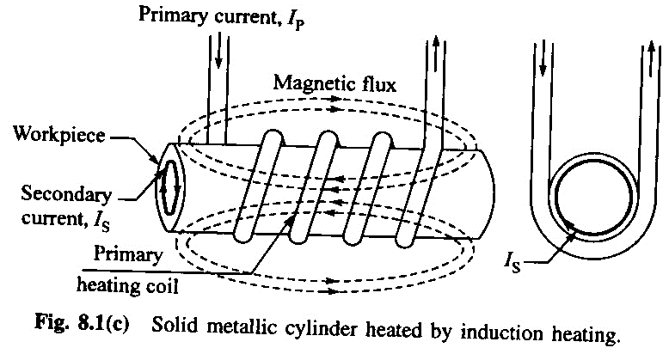
Induction Heating

Slide 17
Induction Heating
The metallic charge is kept within the alternating magnetic field.
When voltage is applied across the coil, an emf e is induced
e = - N (dф/dt)
Where
N is the number of turns in coil
ф is magnetic flux

Slide 18
Induction Heating
The alternating currents produced by the induced emf e, are known as the eddy currents.
These eddy currents will be responsible for generating the required amount of heat.
As the supply frequency is increased, the eddy current will increase which will cause more heat to be produced.

Slide 19
Induction Heating
Eddy current losses can be expressed by
W_{e} = K₁*f²*(B_{m})²*V
Where
f is supply frequency
B_{m} is maximum flux density
V is the volume of object

Slide 20
Induction Heating
In induction heating, as the supply frequency increases, a greater part of the induced heating current tends to concentrate close to the surface due to skin effect.
Therefore, the skin effect decreases the depth of penetration of current and thus increases the current density at the surface.

Slide 21
Induction Heating
In case of magnetic charge, hysteresis loss is also responsible for the total heat generated.
W_{h} = K₂*f*(B_{m})^{1.6}*V
An important point to note is that hysteresis loss takes place only up to the curie temperature.
Above this temperature, this loss does not exist as magnetic properties vanish.

Slide 22
Induction Heating
Some of salient points regarding induction heating are:
Magnetic materials will get heated up faster than non-magnetic materials due to higher permeability value.
The depth of heat penetration can be controlled by the supply frequency.

Slide 23
Induction Heating
For a given material and frequency, the temperature can be controlled by varying number of turns in coil.
More resistive materials can be heated faster than less resistive materials.

Slide 24
Induction Heating
Different frequencies are used for different purposes in induction heating case.
50 Hz frequency is used for melting purposes
0.5 to 4 kHz is used for forging, annealing and deep surface hardening processes.
100 kHz to 1 MHz is required for brazing and soldering purposes.
For high frequency heating a frequency converter device has to be used.

Slide 25
Induction Heating
Induction heating has been widely adopted in metal-works industries because of following advantages:
Very high heating rate.
It is possible to heat small portion of metal instead of heating the entire piece.
Wastage of heat can be avoided.
No flue gas or ash, etc.

Slide 26
Induction Heating
Some drawbacks of this type of heating are:
The efficiency is quite low because
Need for conversion of supply frequency (50 Hz)
Low induction coil efficiency
The system needs a frequency converter which makes the process costly and complex.

